Slide 1
FPGA Packet Filter With Custom Ethernet MAC and Webserver on RISC-V
Undergraduate thesis semiar
Student : Matthew Gilpin 45801600
Supervisor: Dr Matthew D’Souza

Slide 2





Contents
01
04
07
Motivation
Literature Review
Implementation
02
05
Progress
Project Plan

Slide 3
Edge networks
Move computing to the edge – closer to the source of data.
Low power, highly distributed systems.
Increasing security is needed

Slide 4
Literature Review
FPGAs
Packet filtering firewalls
Ethernet MAC
RISC-V
Web server

Slide 5
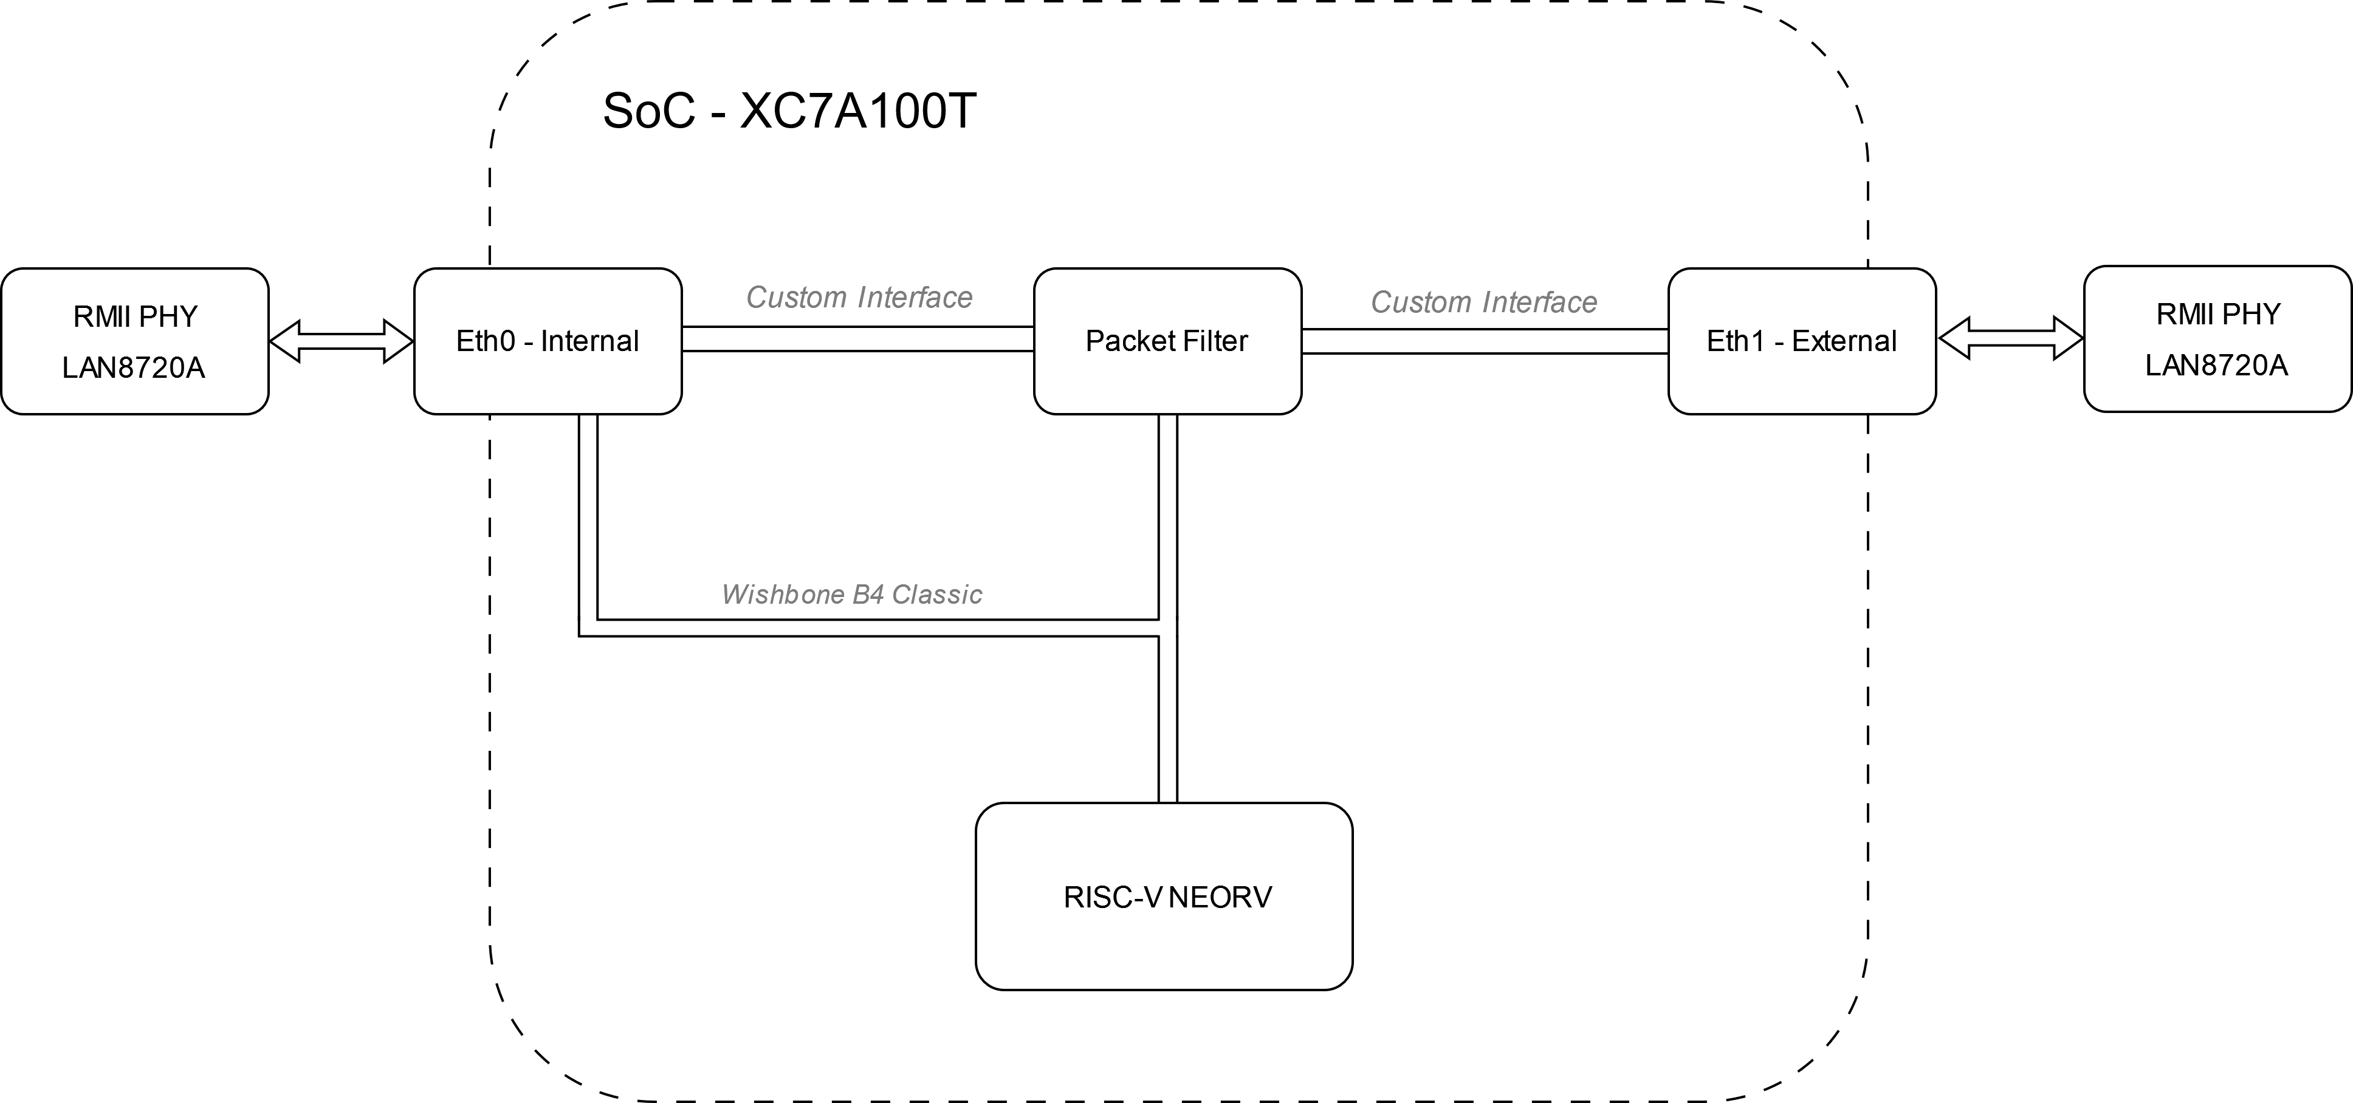
Implementation
Using neorv32 – RISC-V softcore written in vendor agnostic VHDL
Custom Ethernet MAC
FreeRTOS with FreeRTOS Plus TCP stack

Slide 6
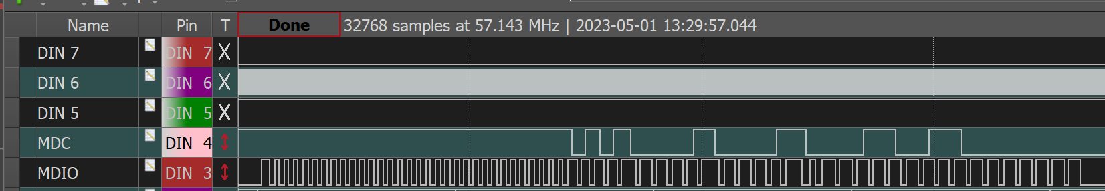
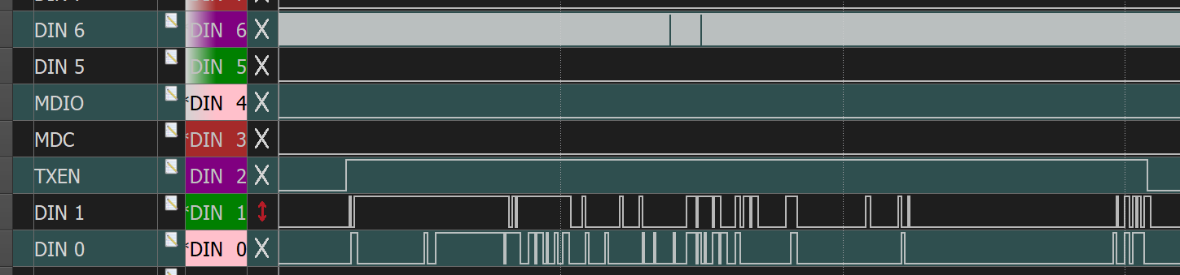
Progress

Slide 7
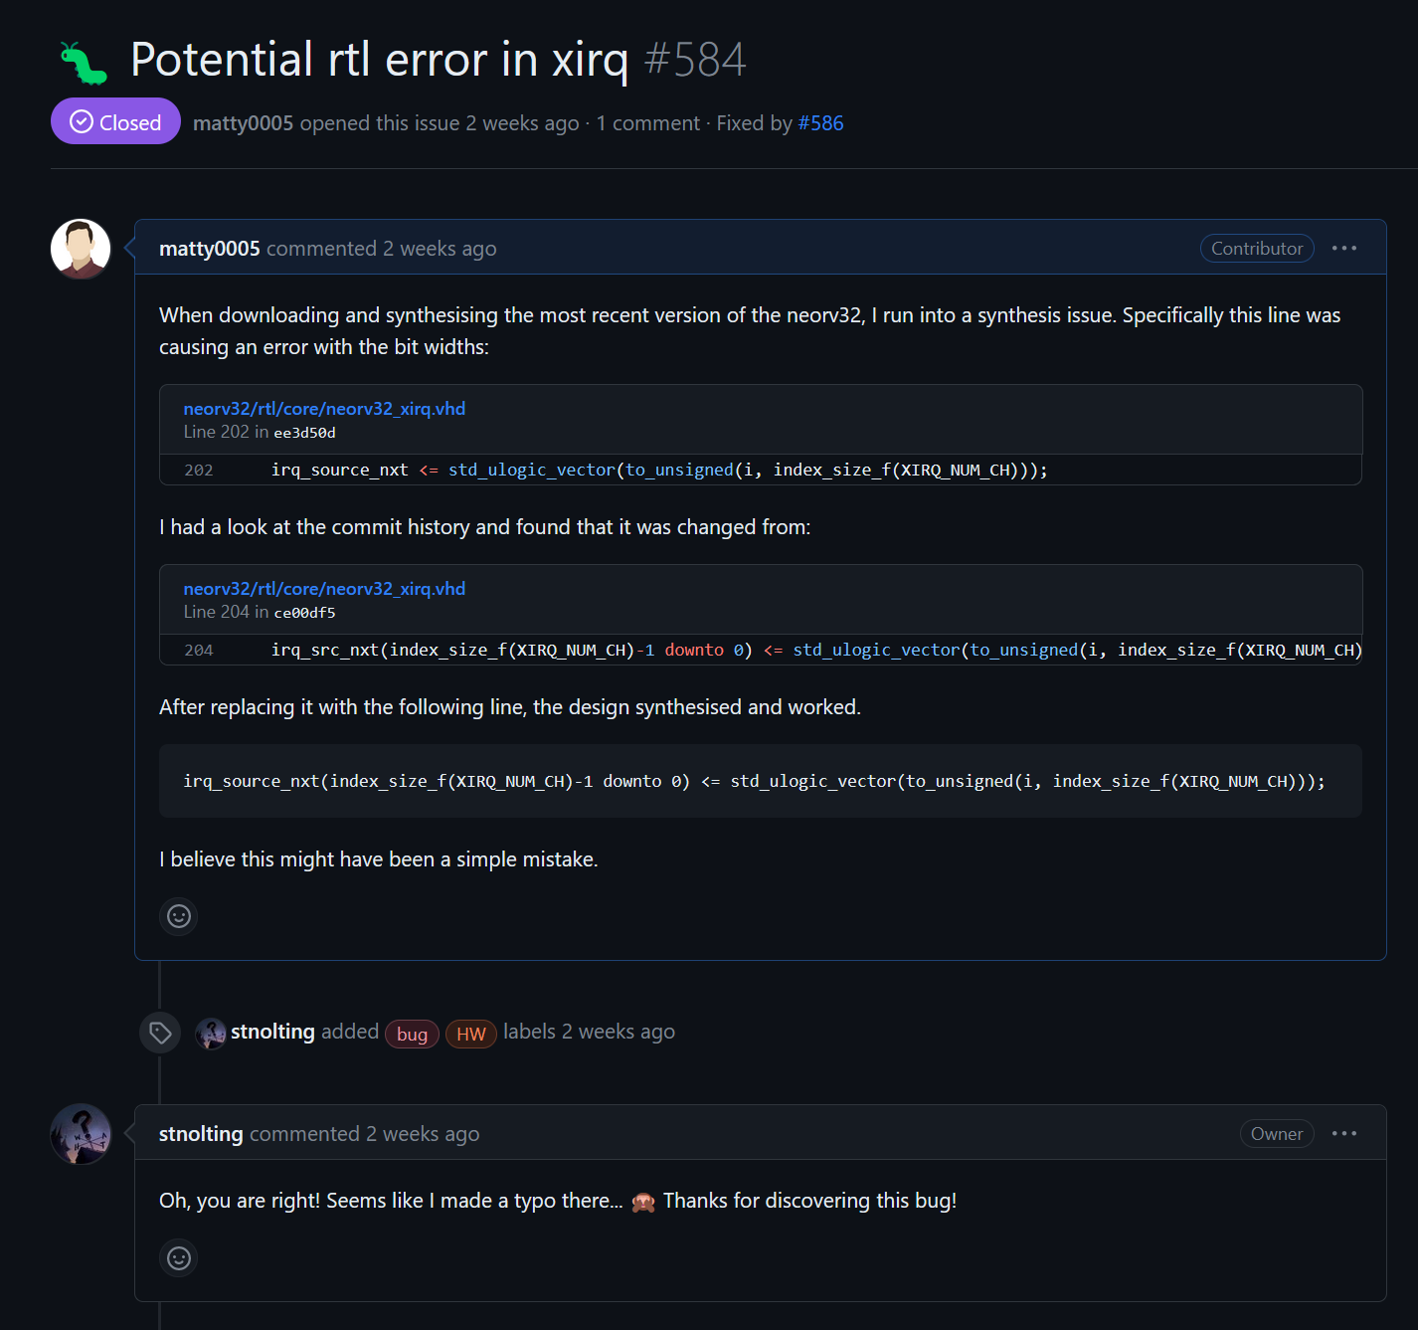

Contributions – neorv32
Detected hardware errors + added external interrupts with FreeRTOS example.

Slide 8
Project plan

Slide 9
Contact
Matthew Gilpin
m.gilpin@uq.edu.au

